Slide 1
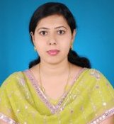
The Graduate School College for Women Jamshedpur Bachelor of Education Kolhan University, Chaibasa
Dr. Meenu Verma
Assistant Professor
B.Ed. Semester-I
Enhancing Professional Capacity EPC-I
UNIT - I
Lecture 3

Slide 2
Lecture 2
Dr. Meenu Verma
https://www.youtube.com/watch?v=G6-Wsj-8Y3I&t=119s
Different types of Memory unit of Computer with their abbreviation

Slide 3
Lecture 2
Dr. Meenu Verma
Smallest unit
B- Byte
KB- Kilobyte
MB-Megabyte
GB- Gigabyte
TB-Terrabyte
PB- Petabyte
EB- Exabyte
ZB- Zettabyte
YB- Yottabyte
BB- Brontobyte
GpB/GeB- Geopbyte
Different types of Memory units of Computer and their abbreviation
b- Bit
nib- Nibble
Kb- Kilobit
Mb-Megabit
Gb- Gigabit
Tb-Terrabit
Pb- Petabit
Eb- Exabit
Zb- Zettabit
Yb- Yottabit
Bb- Brontobit
Gpb/Geb- Geopbit
largest unit

Slide 4
Dr. Meenu Verma
UNDERSTAND
Relation between different Memory units of computer

Slide 5
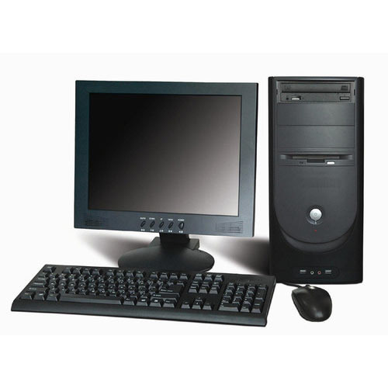
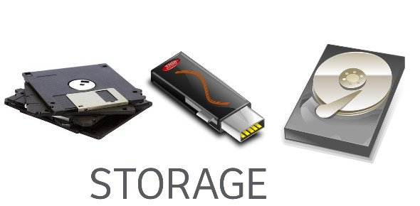
UNIT I
Dr. Meenu Verma
COMPUTER MEMORY UNITS AND MEASUREMENT
Lecture 3

Slide 6
Relation between different Memory units of computer
Dr. Meenu Verma

Slide 7
Relation between different Memory units of computer
Dr. Meenu Verma
b- Bit
nib- Nibble
Kb- Kilobit
Mb-Megabit
Gb- Gigabit
Tb-Terrabit
Pb- Petabit
Eb- Exabit
Zb- Zettabit
Yb- Yottabit
Bb- Brontobit
Gpb/Geb- Geopbit
1 Nibble= 4b= 2² b
1BYTE=8bit=2³ b
1Kb = 1000 b = 10³ b
1Mb =1000² b = 10⁶ b
1Gb = 1000³ b = 10⁹b
1Tb = 1000⁴ b = 10¹² b
1Pb = 1000⁵ b = 10¹⁵ b
1Eb = 1000⁶ b = 10¹⁸ b
1Zb = 1000⁷ b = 10²¹ b
1Yb = 1000⁸ b = 10²⁴b
1Bb = 1000⁹ b = 10²⁷b
1Gpb/Geb = 1000¹⁰ b = 10³⁰ b

Slide 8
Relation between different Memory units of computer
Dr. Meenu Verma
2¹⁰⁰
BYTE
NIBBLE
BIT
KILO BYTE
MEGA BYTE
GIGA BYTE
PETA BYTE
EXA BYTE
TERRA BYTE
ZETTA BYTE
YOTTA BYTE
BRONTO BYTE
GEOP BYTE
1024 BB
2⁹⁰
1024 YB
2⁸⁰
1024 ZB
2⁷⁰
1024 EB
2⁶⁰ = 1152921504606846976
1024 PB
2⁵⁰ = 112899906842624
1024 TB
2⁴⁰ = 1099511627776
1024 GB
2³⁰ = 1073741824
1024 MB
2²⁰ = 1048576
1024 KB
2¹⁰ = 1024
1024 BYTE
2³ b
8 BIT
2² b
4 BIT
BINARY UNIT

Slide 9
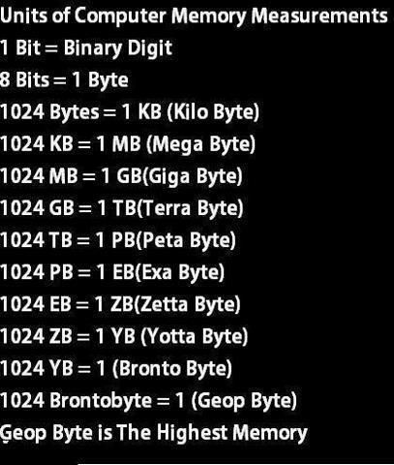
REVISION
Dr. Meenu Verma

Slide 10
Dr. Meenu Verma
CONVERSION BETWEEN ONE UNIT TO OTHER

Slide 11
Are you able to answer
Dr. Meenu Verma
1nib = ___ b
1KB = ___ b
1GB= ___MB
1GeB= ___BB

Slide 12
The Graduate School College for Women Jamshedpur Bachelor of Education Kolhan University, Chaibasa
Dr. Meenu Verma
To be continue in Lecture 4
CONVERSION BETWEEN ONE UNIT TO OTHER

Slide 13
Dr. Meenu Verma

